Slide 1
Table of Contents
Angina pectoris
Hypertension
Pericarditis
Tachycardia

Slide 2
ANGINA PECTORIS
Alexandra Kredátusová

Slide 3
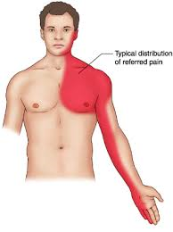
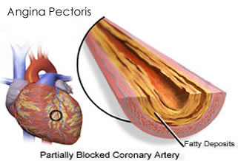
WHAT IS IT?
cardiovascular disease
chest pain due in general to:
ischemia of the heart muscle
oxygen deprivation
obstruction or spasm of the coronary arteries

Slide 4
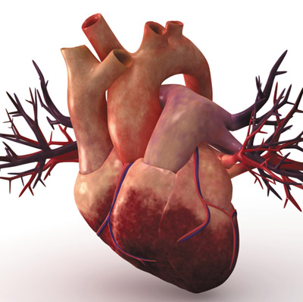
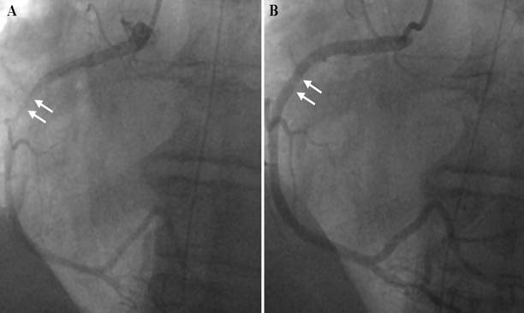
CLASSIFICATION
chronic stable angina
instable angina
vasospastic angina

Slide 5
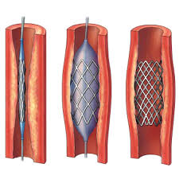
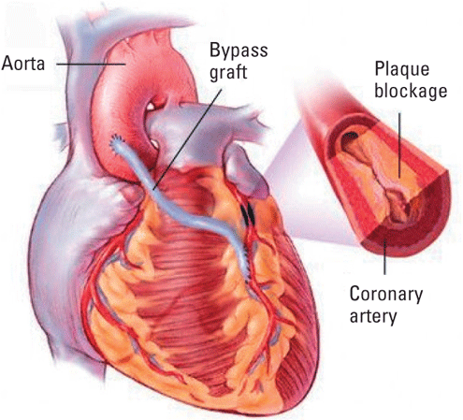
TREATMENT
pharmaceuticals
vasodilators (nitroglycerin)
betablockers
calcium channel blockers
angioplasty
heart bypass

Slide 6
RISK FACTORS
Age
Lifestyle:
smoking
stress
poor&bad nutrition
physical inactivity
obesity
Genetic predisposition
Health status
Diabetes mellitus
Hypertension

Slide 7
Hypertension
Andrea Kapraľová

Slide 8
What it is?
Chronic medical condition
Blood pressure in the arteries is elevated
Disease of affluence
WHO definition - blood preassure 160/95mmHg and higher
Division: - primary (essential) hypertension 85% - secondary hypertension 15%
Notes:
It is a chronic medical condition in which the blood pressure in the arteries is persistently elevated. One of diseases of affluence.
Blood pressure is summarised by two measurements, systolic (1.st number) and diastolic (2.nd number)
WHO definition of hypertension is blood preassure 160/95 mmHg and higher. Bordering value is 140/90 mmHg (normal 120/80)
Hypertension is divided into primary (essential) hypertension and secondary hypertension.
More than 85% of cases are categorized as primary hypertension which means high blood pressure with no obvious underlying medical cause. There are lot of researches about primary hypertension becouse we don‘t know what really cause it. We just can say it is affected by multiplex factors.
The remaining 15% of cases (secondary hypertension) are caused by other conditions that affect the kidneys, arteries, heart or endocrine system.

Slide 9
Symptoms
They are not, at many causes
If they are than these:
Severe headaches
Fatigue or confusion
Dizziness
Nausea
Problems with vision
Chest pains
Tinnitus
Breathing problems
Irregular heartbeat
Blood in the urine
Notes:
There is no guarantee that a person with hypertension will present any symptoms of the condition. About 33% of people actually do not know that they have high blood pressure, and this ignorance can last for years (silent killer). For this reason, it is advisable to undergo periodic blood pressure screenings even when no symptoms are present. It may lead to some symptoms like these:
Severe headaches
Fatigue or confusion
Dizziness
Nausea
Problems with vision
Chest pains
Tinnitus (buzzing or hissing in the ears)
Breathing problems
Irregular heartbeat
Blood in the urine

Slide 10
Diagnosis
Measuring blood pressure with a sphygmomanometer
Electrocardiograms (EKG), echocardiograms
Blood tests
Ophthalmoscopy
Urine tests
Sonography (especially the kidneys)
Hormonal analysis
Chest radiographs
Notes:
A device for measuring blood pressure is called a sphygmomanometer - the device with the arm cuff, dial, pump, and valve. The systolic and diastolic numbers will be recorded and compared to a chart of values. Hypertension is considered proven when at least three measurements on three different days performed sitting down after 5 minutes of peace showing increased blood pressure. Doctors will need to knowthe medical history of you and your family and if you have any of the risk factors.
If hypertension seems reasonable, tests such as electrocardiograms (EKG) and echocardiograms will be used in order to measure electrical activity of the heart and to assess the physical structure of the heart. Additional blood tests will also be required to identify possible causes of secondary hypertension and to measure renal function, electrolyte levels, sugar levels, and cholesterol levels.

Slide 11
Causes/Factors
Genetics and and family history of hypertension
High levels of salt intake
Obesity or being overweight
Lack of physical activity (sedentary lifestyle)
Smoking and alcohol consumption
High levels of Stress
Vitamin D deficiency
Aging
Chronic kidney disease
Notes:
Genetics factors
Children of parents with primary hypertension have compared with children whose parents have normal blood pressure increased blood pressure.
Renal function
Some research claims that patients with hypertension require higher the blood pressure, to achieve the normal excretion of sodium and water by the kidneys.
Salt intake
According to the American Heart Association (AHA), sodium consumption should be limited to 1,500 milligrams per day, and that includes everybody, even healthy people without high blood pressure, diabetes or cardiovascular diseases.
Obesity or being overweight
Whit excess body weight are likely to develop hypertension is caused by increased blood and cardiac capacity. A lowering of the body weight toward the normal values lead to normalization of blood pressure. Especially patients with a genetic predisposition should avoid gaining. Research team at the Indiana University School of Medicine found that obese/overweight children are much more likely to suffer from hypertension during adulthood.
Physical activity
Regular physical exercise can have favorable affect on blood pressure; endurance exercise are recommended.
Smoking and alcohol consumption
Even small amounts of alcohol will cause an increase in blood pressure. Patients with hypertension should strictly limit their consumption of alcohol, in best way entirely eliminate, and avoid any consumption of nicotine.
Stress
Avoiding stress, not only in the profession but also in private life, positively influences the course of the disease. There are highly recommended relaxation techniques, such as: Yoga or autogenous training, as well as sufficient sleep.

Slide 12
How is hypertension treated?
Medically
ACE inhibitors
ARB drugs
beta-blockers
diuretics
calcium channel blockers
alpha-blockers
peripheral vasodilators
Lifestyle factors changes
losing weight
quitting smoking
limiting alcohol consumption
eating a healthful diet
reducing sodium intake
exercising regularly
avoid stress situations
Combination of the two
Notes:
The main goal of treatment for hypertension is to lower blood pressure to less than 140/90 - or even lower. Treating hypertension is important for reducing organ changes and the premature death. High blood pressure may be treated medically; by changing lifestyle factors; or a combination of the two. Important lifestyle changes include losing weight, quitting smoking, eating a healthful diet, reducing sodium intake, exercising regularly, and limiting alcohol consumption.
Medical options to treat hypertension include several classes of drugs. ACE inhibitors, ARB drugs, beta-blockers, diuretics, calcium channel blockers, alpha-blockers, and peripheral vasodilators are the primary drugs used in treatment. These medications may be used alone or in combination, and some are only used in combination. In addition, some of these drugs are preferred to others depending on the characteristics of the patient (diabetic, pregnant, etc.).
If blood pressure is successfully lowered, it is wise to have frequent checkups and to take preventive measures to avoid a relapse of hypertension.

Slide 13
Complications
Cardio-vascular system
enlargement of left ventricular
atherosclerosis in coronary arteries resulting in angina pectoris
heart attack or sudden cardiac death
heart failure
aortic aneurysm
ischemic heart disease
Brain
stroke
dementia
cognitive impairment
Kidney
chronic kidney disease
renal insufficiency
nephrosclerosis (renal arteriosclerosis)
Notes:
Hypertension can lead to damaged organs, as well as several illnesses such as renal failure, aneurysm, heart failure, stroke, or heart attack
Nowdays it is considered that up to 70% of a stroke in patients older than 65 years is found as a result of hypertension.
Death rate
Patients with untreated hypertension almost always die from complications of hypertension. At present, it is considered that about 50% of untreated patients die as a result of coronary heart disease (heart attack) a 33% of cerebrovascular complications (stroke) and up to 15% of renal insufficiency.

Slide 14
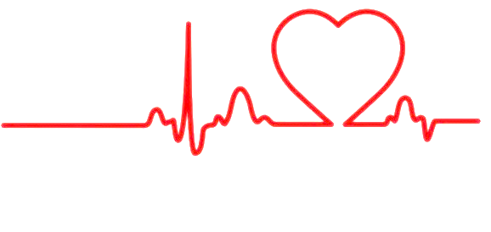
Tachycardia
Lenka Karahutová

Slide 15
Definition
heart rate that exceeds the normal range
heart rate over 100 beats per minute

Slide 16
Symptoms
Dizziness
Lightheadedness
Fainting
Chest pain
Fatigue
Breathlessness

Slide 17
Rise factors
Caffeine, alcohol, tobacco, drug use
Psychological stress, anxiety
Hyperthyroidism
Low potassium and magnesium levels
Heart structural abnormalities
Lung disease
Family history

Slide 18
Differential diagnosis
Sinus tachycardia
Ventricular tachycardia
Superventricular tachycardia
Atrial fibrilation
AV (modal) reentrant tachycardia
Junctional tachycardia

Slide 19
Treatment
Depends on its cause:
Fever- reducing medications
Fluids given intravenously
Blood transfusions
Surgery correction
Antithyroid medications (radioactive iodine)
Beta- blockers
Catheter ablation

Slide 20
Pericarditis
Kristian Leško

Slide 21
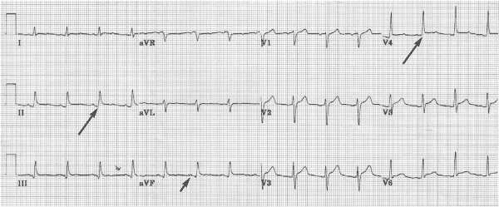
Pericarditis
Pericardium (Greek περι – "around" and κάρδιον – "heart" /perikardion/) – sac containing the heart
Pericarditis – inflammation of pericardium
Acute and chronic form (acute more common)

Slide 22
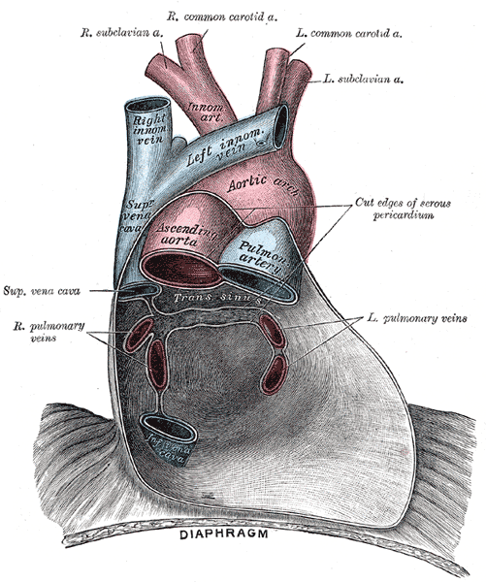

Slide 23
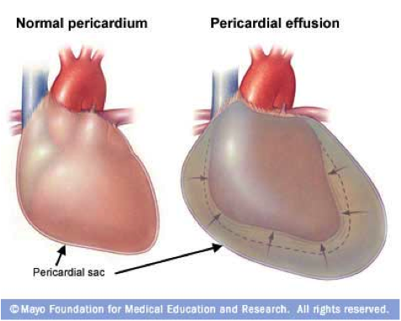
Pericarditis
Causes Classification (composition of exudate)
Infections (e.g., Mycobacterium tuberculosis)
Post-infarct conditions (e.g., Dressler's syndrome)
Idiopathic causes
E.g., serous, purulent, fibrinous, caseous, hemorrhagic

Slide 24
Pericarditis
Symptoms
Sharp, pleuritic, retro-sternal or left chest pain that can radiate to the trapezious ridge, does not change with exertion and worsens when breathing in or lying on back
Pain comes suddenly and can last for hours to days

Slide 25
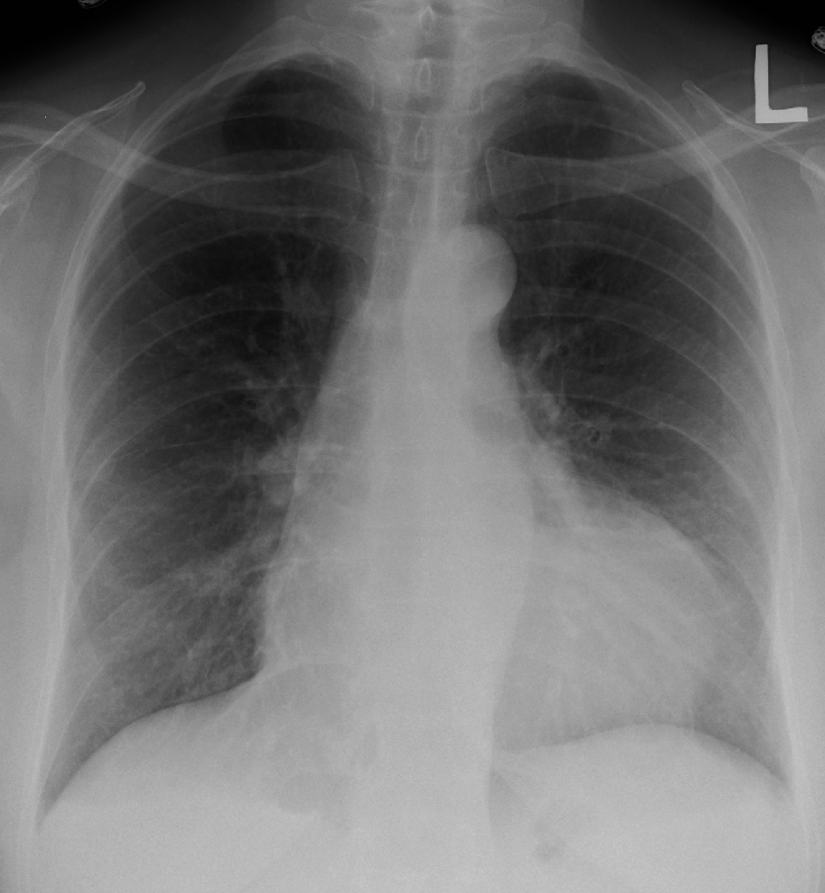
Pericarditis
Diagnosis
Cardiac markers (e.g., myoglobin)
EKG
Clinical diagnosis –cause unknown

Slide 26
Pericarditis
Treatment
Aspirin
Non-steroidal anti-inflammatory drugs (e.g., ibuprofen)
Colchicine
Antibiotics
Steroids (not recommended)
Surgery

